Slide 1
Real Estate Investment Prediction
Presented By Team :CloudBond
Kunjan Malik
Praveen Nayak
Shivam Shrivastav
Yadnyshree Savant

Slide 2
Overview
This project collects data from publicly available dataset for the state of IOWA.
Provide knowledge to an investor or buyers, whether to invest in a housing property or not.
Features like : Selling Price of the property, Zestimate Price, Proximity Ranking to various Schools, Crime Rate in the area, Walk Score etc.

Slide 3
Data Scrapping
Data Scraping:In addition to the above data set we have also scrapped data the
Zillow: https://www.zillow.com
Walk Score: https://www.walkscore.com
School Proximity Rank: https://www.niche.com/places-to-live/z/
Crime rates: https://247wallst.com/city/

Slide 4
CRISP-DM
The project covers all the 6 stages of CRISP-DM :
1.Business Understanding
2. Data Understanding
3. Data Preparation
4.Modelling
5.Evaluation
6.Deployment

Slide 5
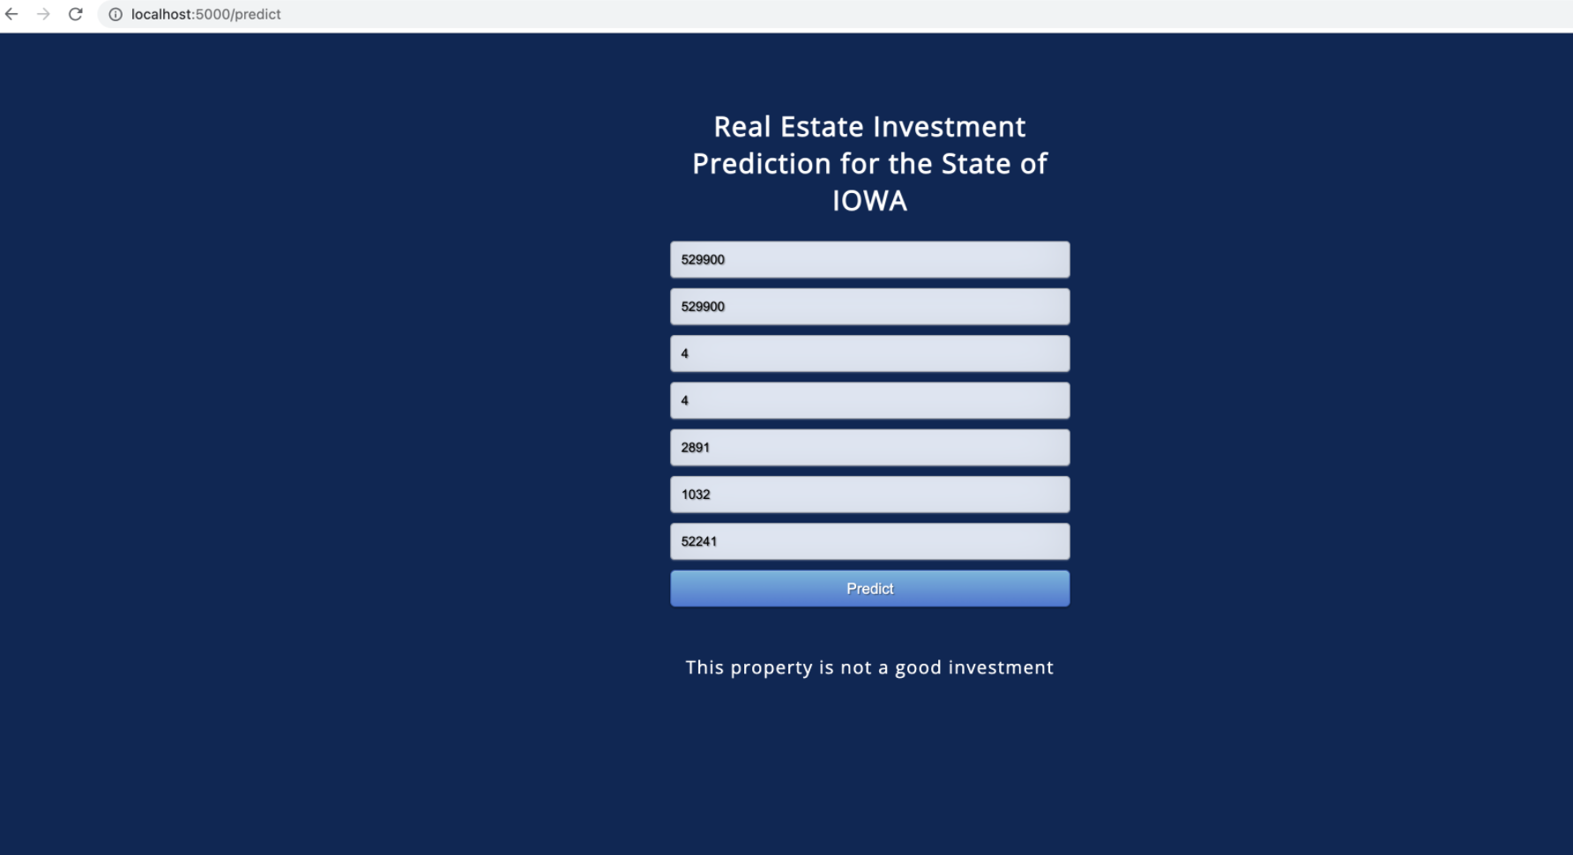
User Interface

Slide 6
Thank You

